Slide 1
Dynatrace & Microsoft

Slide 2
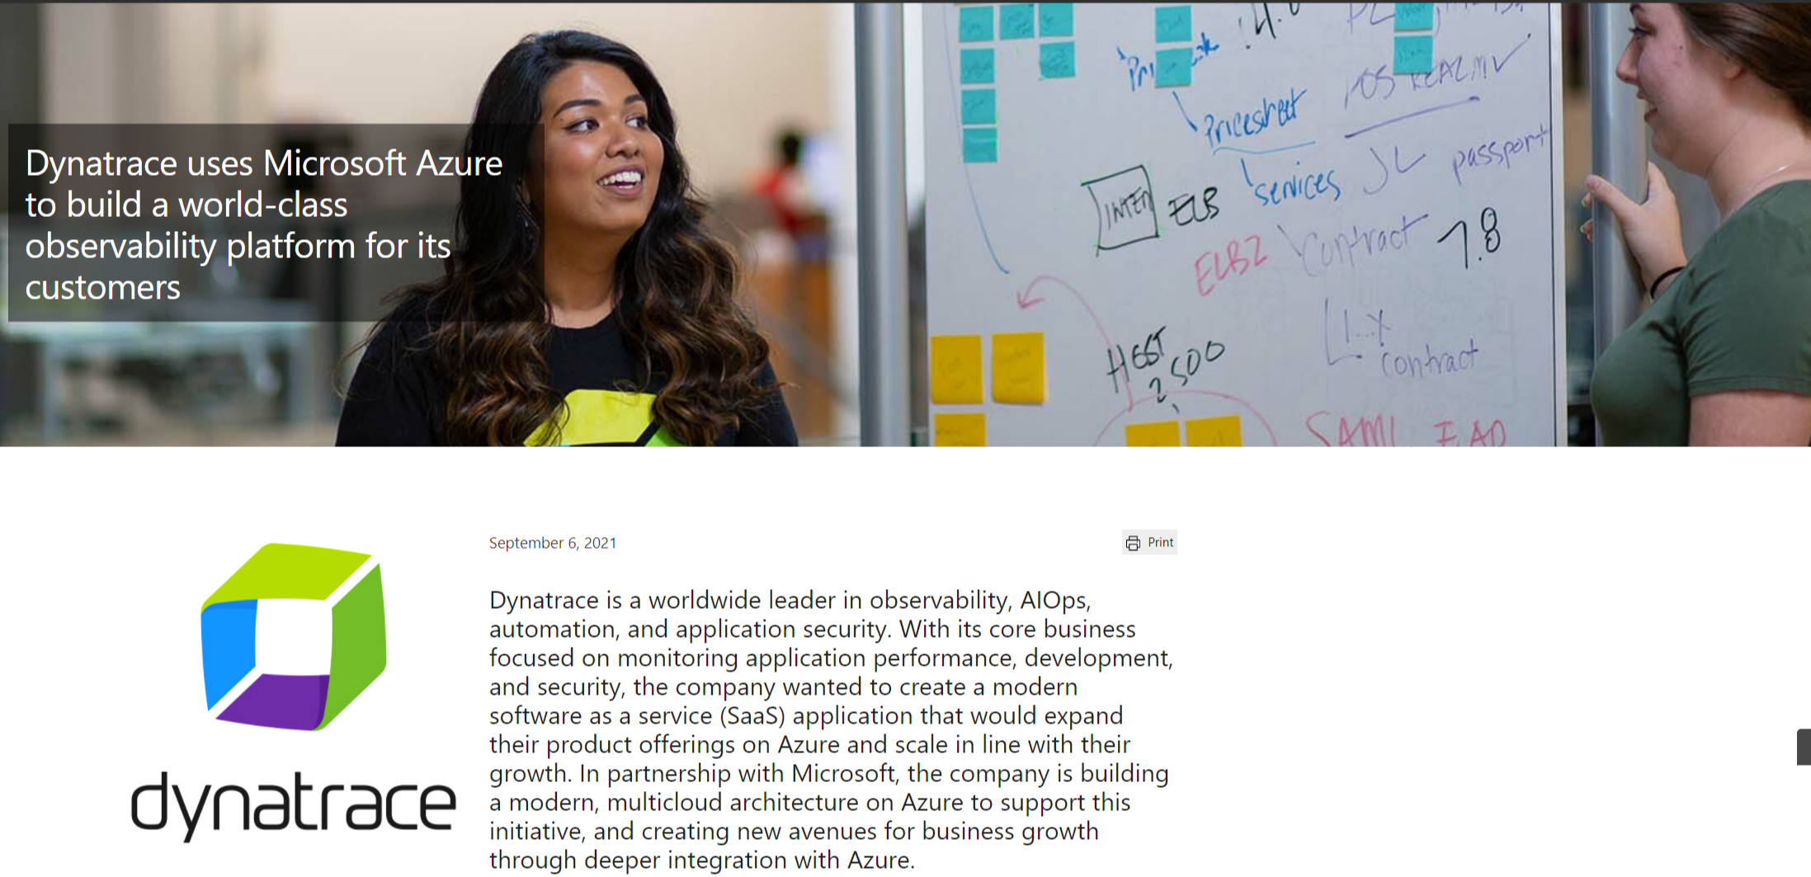
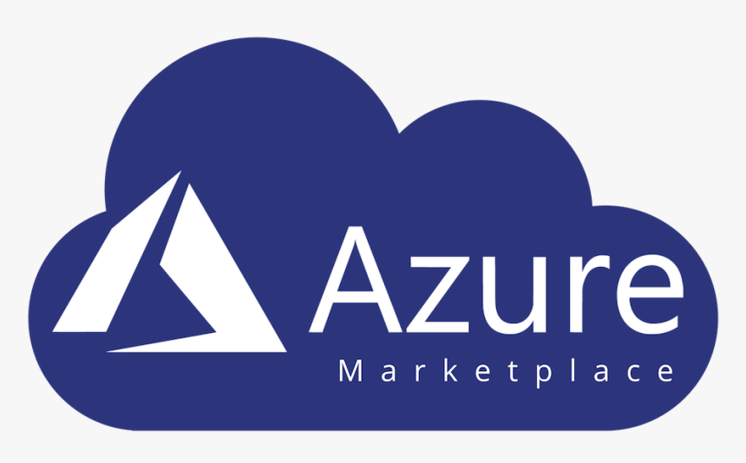
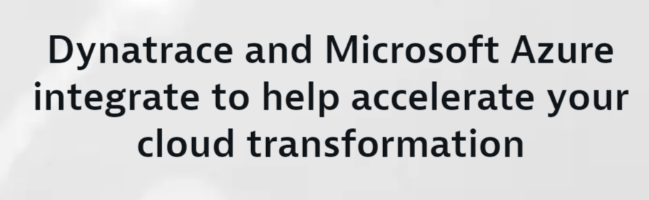

Well-Architected Framework
Cloud Adoption Framework
Marketplace Transactable: Decrement Azure Commit (MACC)
Silver Data Analytics and Data Platform Competency
Azure Native Dynatrace Service
Gold Application Development Competency
Dynatrace and Microsoft

Slide 3







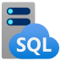

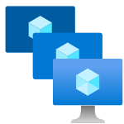
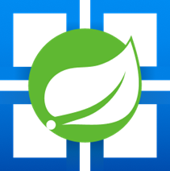



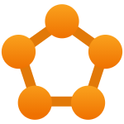


Out of the box support for Azure cloud native architectures
Ever growing support for Azure services
Real-time observability into dynamic environments​
With automatic instrumentation for dynamic microservices and unique hybrid support, Dynatrace monitors your entire cloud including all dependencies in real time with no blind-spots. Dynatrace OneAgent supports byte-code instrumentation for Azure App Service, Web Apps, Azure VMs, Azure Functions, Azure Spring Cloud, Azure Kubernetes Service, Azure VM Scale Sets.
Azure Cognitive Services
Azure Application Gateway
Azure Batch
Azure Blob Storage
Azure Cosmos DB
Azure DB for Maria DB
Azure SQL
Azure Managed SQL
Azure Functions
Azure VM Scale Sets
Azure Spring Cloud
…and many more!
Azure Load Balancer
Azure Machine Learning
Azure Data Lake
Azure Service Fabric
Azure App Service
Azure Kubernetes Service

Slide 4
Cloud Modernization Challenges

Slide 5







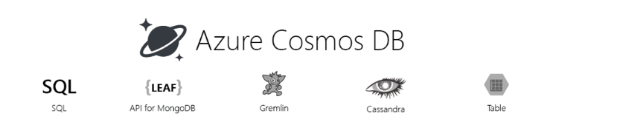
Your Modernization Journey
Move to the Cloud
Containerize Applications
Move-to-Serverless
Build with Cloud-Native
Apps / DBs run on VMs
No code changes
Develop & deploy faster
Application portability
No code changes
License freedom/savings
Performance improvement
Cross-platform support
Microservices-based
Serverless architecture
DevOps model
Applications
Azure Service Fabric
Container Instances
Azure Kubernetes Service
Azure Functions
Azure API Management
Azure App Services
Azure VM
Azure VM Scale sets
VMs ➤ Containers
Azure Functions
Azure Storage Account
Azure CosmosDB
Managed Databases
Move-to-Open Source
Customer operates everything above the infrastructure
Managed provisioning, backups, patching, monitoring & scaling
No code changes
High performance & scalability
Purpose-built database services
License savings
Databases
Azure API Management
Azure Kubernetes Service
Azure
Cosmos DB
Azure MSSQL Managed
On-Prem ➤ Cloud Native
Self-Serve ➤ Managed
Purpose-Built
Build New
Notes:
Your journey in Azure won’t have a finish line
Azure cloud continues to grow and so will their service offering
Your cloud migration will continue to evolve as newer faster, more efficient services are released
Dynatrace will continue to your support and optimize those cloud native services

Slide 6
Modernization Journey & Cloud Adoption Framework Benefits
Automated CI/CD pipeline – data-driven decisions and experiments
Innovation Velocity
DevOps model
AI/ML
Monoliths to microservices,
purpose-built DBs
HW/SW right-sizing
COTS → open source
Offload operational activities
Managed services
Cost of compute and storage
Automation tools
Containers/ serverless
Cost of compute and storage
On premises
Lift and shift
Cloud-native optimized
Cloud-native Optimized
Notes:
The Journey of a thousand miles…
Your first workloads will typically be lift and shift
This will lead to optimization & right sizing exercises
Then automation, new commercial & open source software will begin to drive this transformation forward
This is the most pivotal moment in this journey

Slide 7















Digital
Cloud
experience
automation
Applications &
Mobile, web browser,
microservices
and API
Closed-loop
remediation
Infrastructure
monitoring
Feature adoption
Hybrid cloud
analysis
Quality gate, service
Observability is growing fast
distributed tracing
level, and delivery
Hybrid cloud
Fault domain
observability
isolation
Visual session
Automatic
replay
code-level root cause
DevOps, SRE
Serverless, container,
Application
lifecycle
pod & network
and profiling
security
Digital
business
The importance of observability is increasing, use cases are more diverse, and “observe everything” is the mindset
Frontend & backend
Run-time
availability and
vulnerability detection
performance
Real-time business
insights
Impact analysis
Impact and
DevSecOps
conversion
automation
BizDevOps
integration and
automation

Slide 8

This creates challenges
Metrics
The volume, variety, and velocity of data will exceed the scalability of the observability solutions
Finding answers and root cause will be impossible with human-powered correlation – automated answers and causation are required
Sessions
Logs
Traces
… and more

Slide 9
Solution Overview

Slide 10





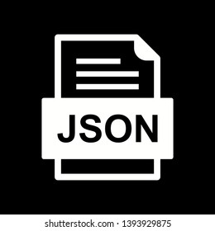

Dynatrace as part of your Modernization Journey
Move to the Cloud
Containerized Applications
Move-to-Serverless
Build with Cloud-Native
Microservices-based
Serverless architecture
DevOps model
Azure VM
Azure Service Fabric
Container Instances
Azure Kubernetes Instances
Azure Functions
Azure API Management
Azure App Services
Applications
Azure Functions
Azure Storage Account
Azure
Cosmos DB
Customer operates everything above the infrastructure
Azure API Management
Azure Kubernetes Service
On-Prem ➤ Cloud Native
VMs ➤ Containers
Purpose-Built
Build New
Notes:
Dynatrace and Azure are purpose built to drive your modernization journey
As you being to move workloads to the cloud
As you begin to leverage cloud best practices
Cloud native services
Azure’s platform form offerings will meet your needs
Dynatrace will help you ensure that they are performing
***

Slide 11
Benefits of Dynatrace for Azure Portal native integration
4
Metrics and Logs
Enable the collection of metrics and logs for VM and App Services resources
1
Integrate onboarding
You can provision Dynatrace and manage the integration through the Azure Marketplace and Portal
5
OneAgent deployment
Install or uninstall Dynatrace OneAgents on single or multiple CMs and Azure App Services directly from the Azure Portal
2
Unified billing
You can purchase Dynatrace via the Azure Marketplace – you can even spend your organization’s Microsoft Azure consumption commitment
6
Manage Dynatrace within Azure Portal
Verify which resources are sending Azure metrics and logs to Dynatrace and make instant changes as needed
3
Single sign-on
Easily enable SSO through Azure Active Directory – there’s no need for separate authentication to the Dynatrace portal
7
Deeper Azure CLI integration
Easily manage Dynatrace resources from the Azure CLI to further extend deployments of those resources
Notes:
Integrated onboarding: You can provision Dynatrace and manage the integration through the Azure portal. This enhanced onboarding experience makes Dynatrace setup automatic, so new users can start monitoring the health and performance of their applications with Dynatrace quickly, whether they are based entirely in Azure or spread across hybrid or multicloud environments.
Unified billing: Dynatrace costs will be reported through Azure monthly billing, making it easier for customers to procure and align Azure and Dynatrace sales.
Single sign-on: No need for separate authentication for the Dynatrace portal. This improves security and compliance and creates a single source for troubleshooting, optimizing performance, and cross-team collaboration.
Logs and Metrics: Enables automated ingestion of Azure Monitor metrics and logs (subscription activity and resource logs) to Dynatrace.
Metrics collection: Automatically send all Azure resource metrics to Dynatrace.
OneAgent deployment: Set up Dynatrace on cloud platforms for operational and business performance metrics, from front-end to back-end. Install or uninstall Dynatrace agents from the Azure portal on single or multiple virtual machines and Azure App Services.
Manage Dynatrace within Azure portal: You can verify which resources are sending Azure metrics and logs at a glance, and make changes as needed.
Deeper Azure CLI integration: You can easily manage Dynatrace resources from Azure CLI to further extend deployments of those resources with ARM templates or other third-party IAAC platforms, such as Terraform.

Slide 12
What the hack environment setup

Slide 13
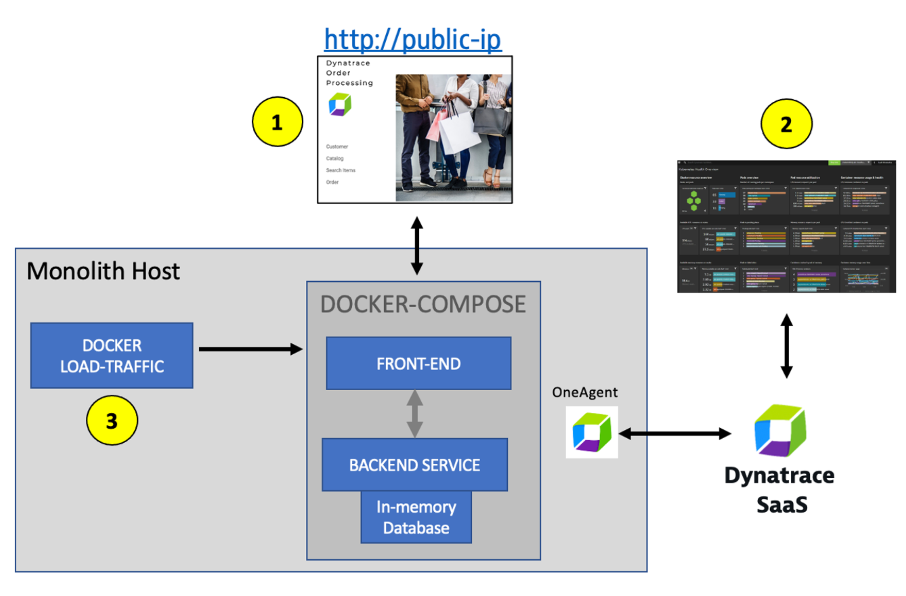
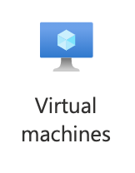

Workshop Environment for Monolith VM

Slide 14
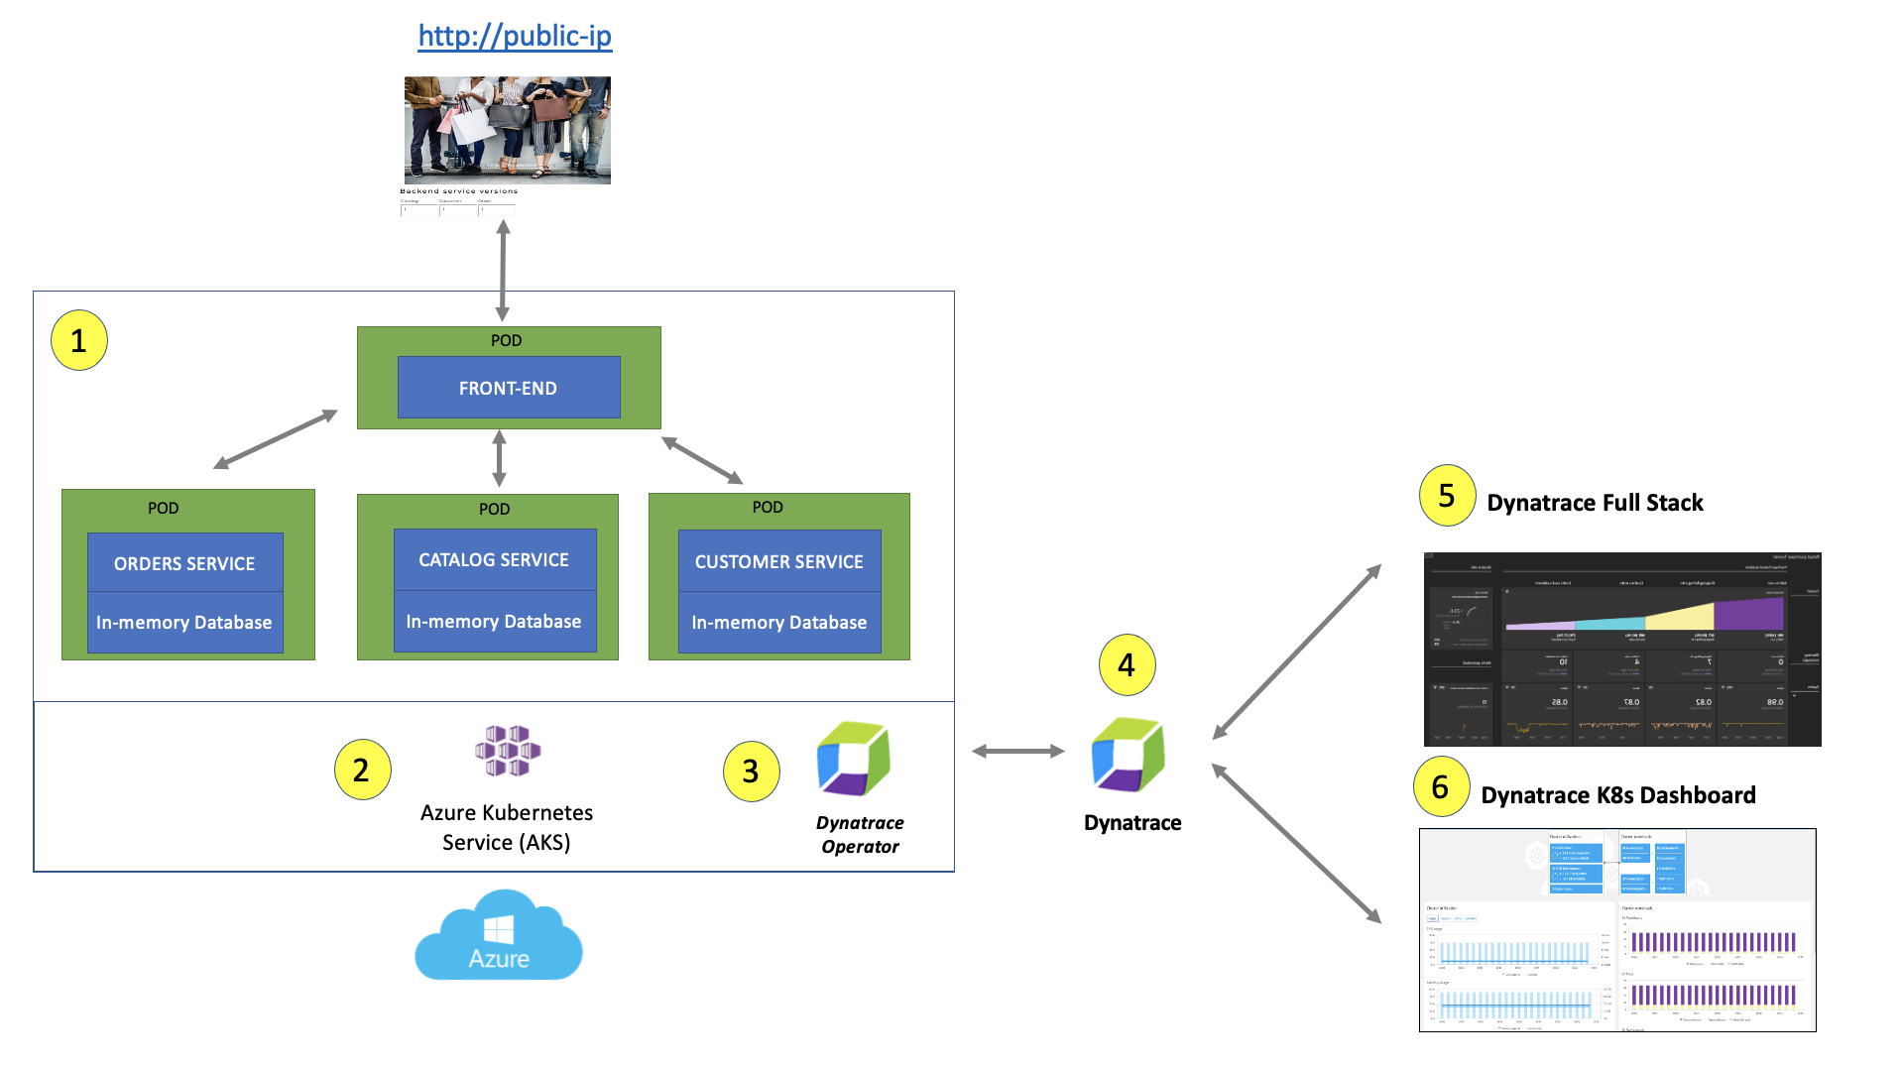
Workshop Environment for AKS

